Slide 1
Big Mountain Resort

Slide 2
Problem Identification
Big Mountain Resort wants to increase revenue and ticket prices.
An additional chair lift increased operating costs by $1,540,000.
Around 350,000 skiers or snowboarders come every year
Customers get access to over 100 trails
Is Big Mountain Resort capitalizing on all its facilities, and do the ticket prices reflect that?

Slide 3
Recommendation and Key Findings
Key Findings
Big Mountain Resort is either the same or better than its peers in multiple categories. These categories included the area covered by snowmakers, vertical drop, the total number of chairs, the total number of runs, and more.
Montana ranks in the 40th percentile out of 35 states in average ticket prices.
Recommendation
Our recommendation is to increase ticket prices from $81 to $85.34 per day per customer. If the data shows that customers are willing to pay that and demand has not decreased, then continue to raise the price to a maximum of $106.40.

Slide 4
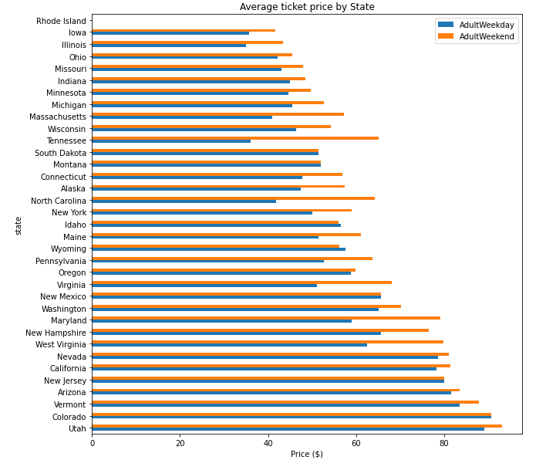
Modeling Results and Analysis
Montana is ranked 13th out of all the states that have a resort.

Slide 5
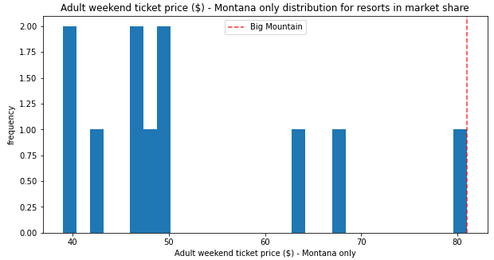
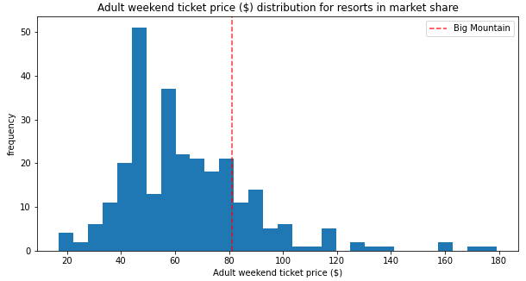
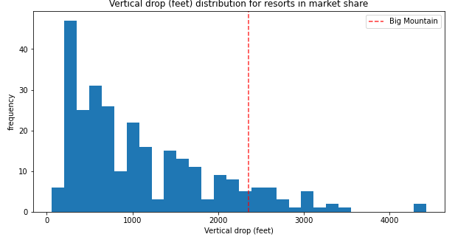
Modeling Results and Analysis (cont.)
Here are some charts that compare Big Mountain Resort to its peers.

Slide 6
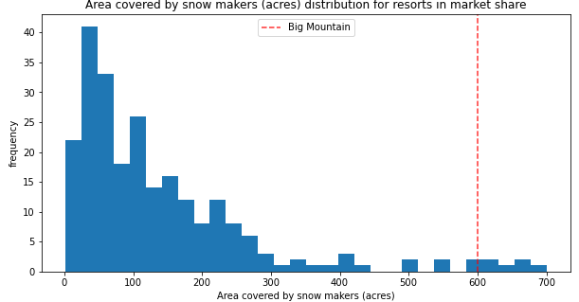
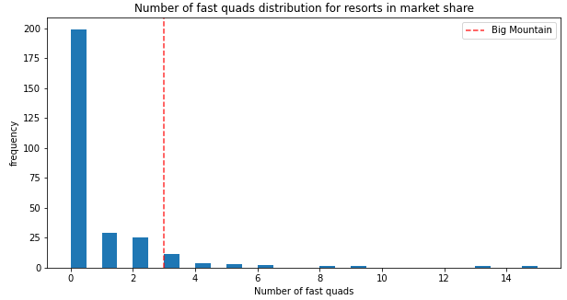
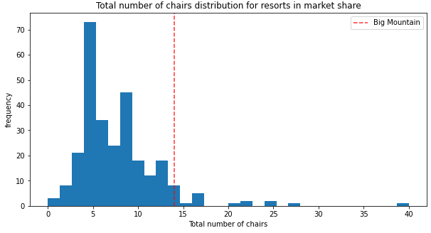
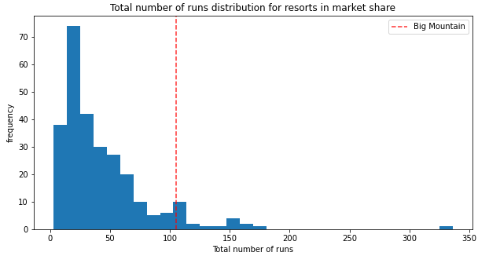
Modeling Results and Analysis (cont.)

Slide 7
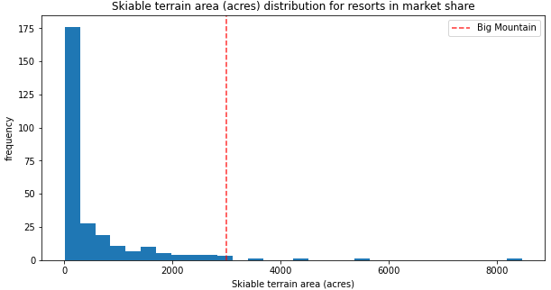
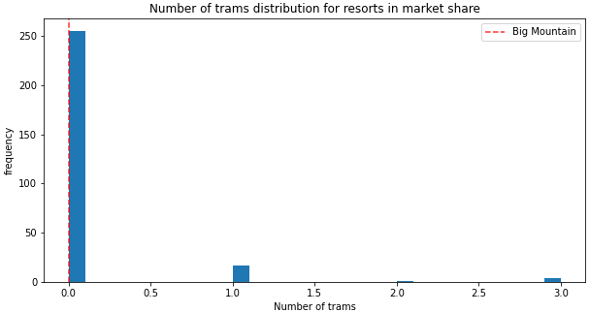
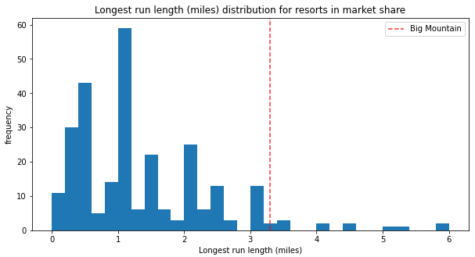
Modeling Results and Analysis (cont.)

Slide 8
Summary and Conclusion
The data we have collected points to increasing ticket prices slowly. Big Mountain Resort continues to prove that it is one of the best resorts compared to its peers. Once revenue is increased, the resort can use those funds to improve its facilities and give customers a better experience.
Thank you for using our services and we hope to hear from you soon on your success.

